Slide 1
Data Flow Methodology
Steve Chenoweth & Sriram Mohan
Question 6
Notes:
This is a widely used generic way to show how systems work – popular with systems engineers and business people, as well as for our purpose – modeling a software system.

Slide 2
Outline
Basics
Levels of Detail
Bad and Good DFD practices
Notes:
We’ll discus what it is first, then how you do it, then how to do it right!

Slide 3
What is it?
A model that indicates the flow of data through a system.
Represented using Data Flow Diagrams(DFD)
Notes:
DFD representation concerns things like where the data will come from and go to as well as where it will be stored.
It abstracts-out things like sequence or timing of operations. Why would you leave out the order in which things happen? That’s Quiz question 1, coming up!

Slide 4
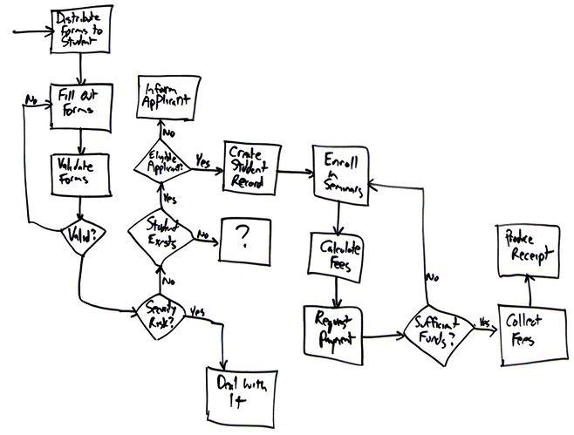
In class we’ll discuss this point further…
What is the difference between a DFD and a flow chart?
Here’s your basic flowchart, from http://www.agilemodeling.com/artifacts/flowChart.htm
Question 1
Notes:
A flow chart shows flow of control, not data, whereas many different data flows can occur in parallel in a data flow model, there is only one locus of control that flows around in a flow chart.
Thus, a flow chart DOES show the order in which things happen.

Slide 5
Notation
Where the data comes from and where the data leaves the system
Source/Sink
Process
A transformation or validation of data
A storehouse of data like a database or file
Store
Uni/bi directional - Used to indicate flow
Notes:
Sources and sinks usually represent the actors of the system and the processes can be used to represent how the various actors modify/transform the data in the system.

Slide 6
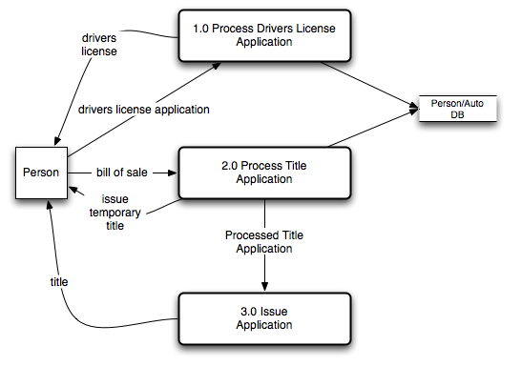
Example - License Branch
Notes:
In this example, we see the main activities that a person usually does, when they go to a state-run auto license branch, in the US. The two main activities are:
Get or renew your driver’s license, which makes you legally able to drive a vehicle on a public road. And,
Do the paperwork associated with a vehicle, such as getting a title (and license plates – not shown, above).
The title activity actually has multiple artifacts and processes, as shown in 2.0 and 3.0 in the DFD.
The “bill of sale” is proof that you bought a car, which, as shown, you the “Person” give to the “process” 2.0, which then issues you a temporary title.
The DFD shows the “things” involved in these activities, and which direction they go.
Try to picture how the rest of this works, from the DFD.

Slide 7
Structural Recursion
Process nodes may have internal details that may be exploded
Allows top level or detailed overview of any process
  Process is overloaded in software engineering and means a lot of things..
Notes:
This is a big problem with all graphical ways of showing how systems work – the systems themselves are so messy that the pictures end up being a big mess, too.
A standard way to simplify all of them is to make hierarchies (levels), with blocks in them which actually represent a whole bunch of things at a lower level.

Slide 8
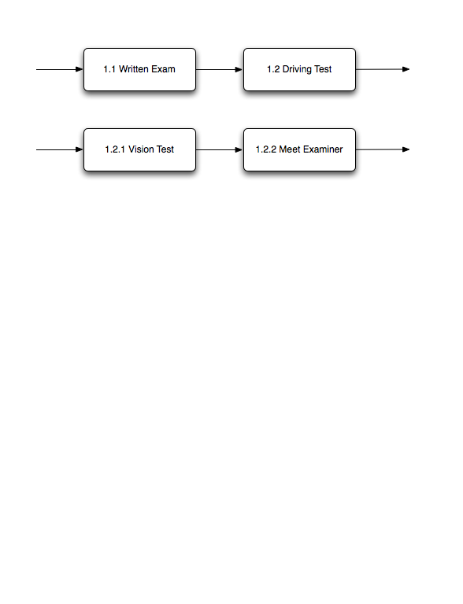
Example - License Branch Explosion
Must be
distinct diagrams
Notes:
These are all things that happen within the process of applying for and getting a driver’s license. This was just “1.0” in our original DFD, on slide 6.

Slide 9
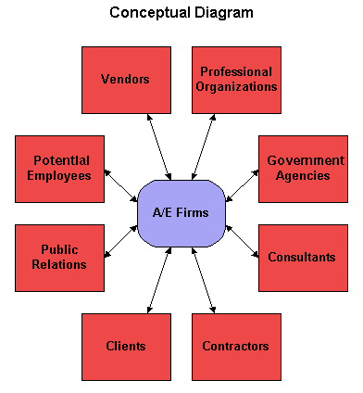
Types of a DFD
Current versus the Proposed System–
  Doing the first confirms what you think you know about how things are!
Physical versus Conceptual
  Conceptual DFD is a simple way to start.
Conceptual DFD from http://www.umsl.edu/~sauterv/analysis/6840_f03_papers/vanemden/index.html
Question 2, part of 3
Notes:
Sometimes information is recorded on and closely associated with particular pieces of paper. A way to describe the information process is to track the actual physical flow of these pieces of paper. When the information is described more abstractly, then it is a conceptual data flow. Conceptual DFD’s are usually a refinement of the physical DFD. However, there are cases where it is not true. When there are a lot of people involved in pushing a piece of paper, everybody is represented in the physical flow, however the conceptual flow will represent everything using just one arc.

Slide 10
How do you get started doing DFD’s?
Step 1: Develop the Context Diagram
  Shows how project fits into the larger environment
  Represents physical flow/communication
  Sinks and Sources must be shown
  A process is shown only if it is visible to the external environment.
  Explode as necessary.
Notes:
A context diagram is mostly a drawing of the physical flows of the system, but with some contextual information thrown in to avoid trivial DFD’s.

Slide 11
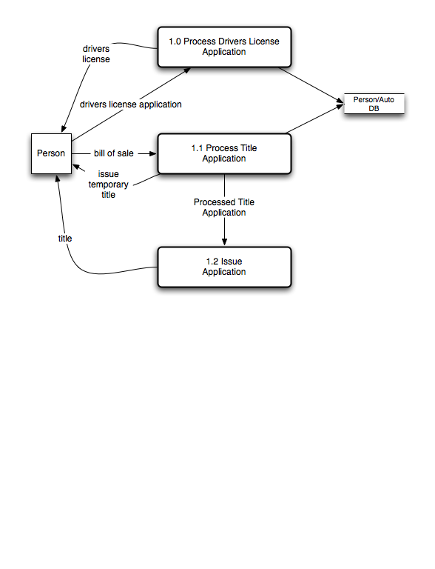
Example - License Branch
Notes:
Here’s the top level of the License Branch again, same as slide 6.
The paperwork, like the driver’s license, are things that “flow” between entities, during the processes shown in the middle of the figure.
The arrows to the DB are not made specific, which is something we would want to do!

Slide 12
Levels of Details
Context Diagram
  Main External Environment
Level 0 Diagram
  Main focus is top-level internals
  Might be the same as the context diagram for small projects
  Sources and Sinks need not be shown, but represent the flow
Level i Diagram
  Provides a higher level of detail for nodes in level i-1
  Use “Dewey decimal” notation to clarify relationships
    Node 2.3 expands to 2.3.1, 2.3.2 and so on
Part of Q 3
Notes:
The context diagram shows how the system fits into its environment, whereas the rest of the figures tend to show things within the system, and how they interact.
If you consider “requirements” to be knowledge coming from outside your development group, then probably the Context Diagram is the main DFD that we’d call purely “requirements.” The rest of the DFD’s involve at least some “design.” They say how we decided to break-down the system into components, or sub-processes, which is partly our own choice.
However, these “Level i” diagrams to SHOW other requirements – because they show things in more detail that the customer actually asked for.

Slide 13
Example - License Branch Explosion
Must be distinct diagrams for each of these, eventually, to show their detail!
Notes:
This is just slide 8 again.
Notice that, in design, there is a lot more to say about how these sub-processes would work. Like, exactly how does the system get involved in providing the Written Exam? Does it have to show these on PC’s in the License Branch, and grade them?
Thus, in these lower-level DFD’s, we have some of our design work shown, as well as more detail about the requirements the customer wants.

Slide 14
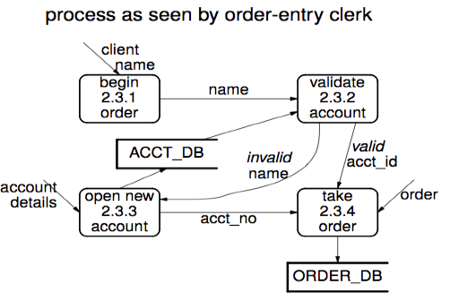
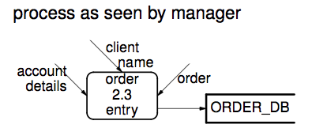
Levels and Perspectives
View of process depends on positions
→ Do the “slide show” of this slide, to see both views!
Question 6
Notes:
DFD’s can show different perspectives of the system, so you can use them with different stakeholders.

Slide 15
How far to Expand?
A process can always be further expanded to sub-processes
How far should we expand?
Notes:
The intent is to account for information flow. If there is more detail then expand, until all information flow is covered.
The big question with all forms of documenting your system – When to stop and move on to doing something else!

Slide 16
The Trivial DFD
Every information system has the same model
Input
Process
Output
This is not enough!, Capture Specific sources and sinks
Question 7
Notes:
This is obviously too shallow to show anything important!
“Sources” and “sinks” are a common terminology for many different kinds of figures, not just for DFD’s. Look this up! (It’s in one of the Wikipedia definitions, for example.)

Slide 17
The Trivial DFD….
In Interactive systems, another trivial DFD is
User
System
Notes:
This could be almost any interactive system!

Slide 18
What do you think?
Proc 1
Classify &
Direct
Proc 2
User
Proc 3
Question 8

Slide 19
Some Problems (with the previous slide)
There is a monolithic user
Don’t capture menu selection (the flow of control) in a DFD
How can you correct this?
  Show all user roles
  Separate user selection at input

Slide 20
A Better DFD
Proc 1
Internal User
Proc 2
External User
Proc 3
Question 9

Slide 21
Advantages of DFD
It is the first step towards implementation
It helps guide the development of user interfaces
  Guides the user through choices and avoids meaningless steps
Good way to verify requirements with your client.
Questions 4,5
Notes:
DFD is an excellent bridge between specification and implementation.

Slide 22
Team Work – We’ll do this in class…
As a team try to draw Context, Level 0, Level 1, 2….n data flow diagrams for the degree planner project. Please turn in your work

